Slide 1

Julia is not [ anything at ] all about being fast, But it helps!

Slide 2
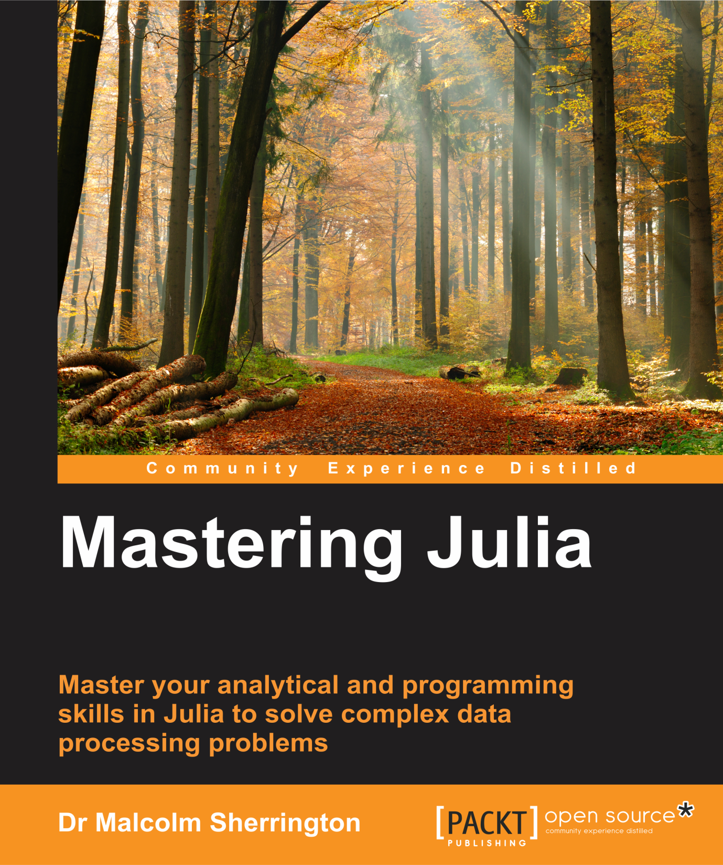

Slide 3
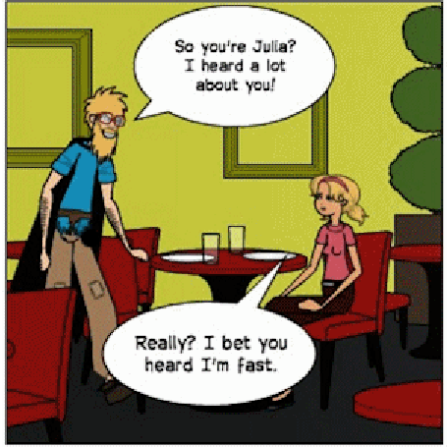

Slide 4
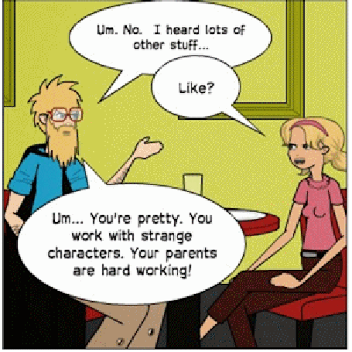

Slide 5
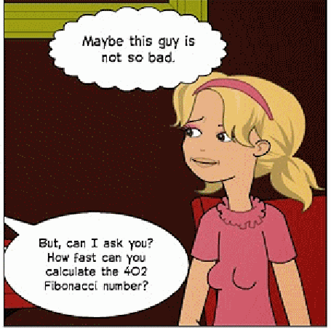

Slide 6

What’s the Big IDEA?
Julia parses the code into a Lisp – like format
This is converted to LLVM Intermediate Representation
Then it is compiled to the machine code

Slide 7
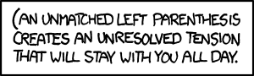
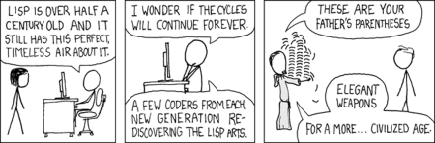
Lost In a Sea of Parentheses

Slide 8
julia --lisp;
; -
;|_ _ _ |_ _ | . _ _
;| (-||||_(_)|__|_)|_)
;------------------|------------
> define (incr x) (+ x 1))
> (incr 2) ; => 3
> (incr 2.3) ; => 3.3
> (inc 2/3) ; => eval: variable 2/3 has no value
> (inc (/ 2 3)) ; => 1.666666666666667
>(inc (// 2 3)) ; => eval: variable // has no value

Slide 9
(define (fac n)
(if (<= n 0) 1
(* n (fac (- n 1)))
)
)
> (fac 10) ; => 3628800
> (fac 20) ; => #int64(2432902008176640000)
> (fac 30) ; => #uint64(9682165104862298112)
> (fac 40) ; => -70609262346240000
> (fac 90) ; => 0

Slide 10
(define (fib n)
(if (< n 2) n
(+ (fib (- n 1))
(fib (- n 2))
)
)
)
> (fib 10) ; => 55
> (fib 20) ; => 6765
> (fib 30) ; => 832040
> (fib 40) ; => 102334155 (~ 13 sec)
> (fib 42) ; => 267914296 (~ 37 sec)

Slide 11

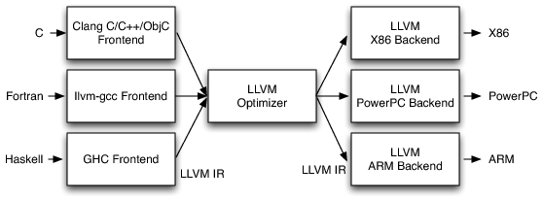
LLVM project
http://llvm.org
LLVM IR : Low Level Virtual Machine Intermediate Representation

Slide 12
Julia Code Generation Phases
Parsing (AST)
Lowering (AST)
Type inference & optimization (AST)
LLVM IR
Assembly code

Slide 13
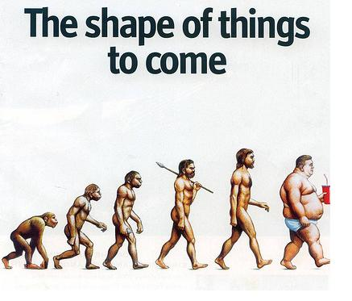

Slide 14

Python, R, Julia or something else ?

Slide 15
Some random thoughts
No one would create a language as slow as Matlab, R (or even) Python again
Speeding up Python ain’t that easy
Languages on the JVM need the JVM
Parallelism will become more significant
LLVM / JIT has opened up Pandora’s box

Slide 16
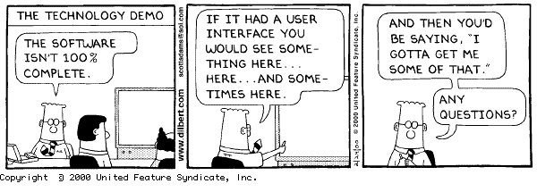
Questions ?

